Slide 1
Let us go to the market...
43026- Energy Economics, Optimisation and Policy
Tutorial1: Energy Economics

Slide 2
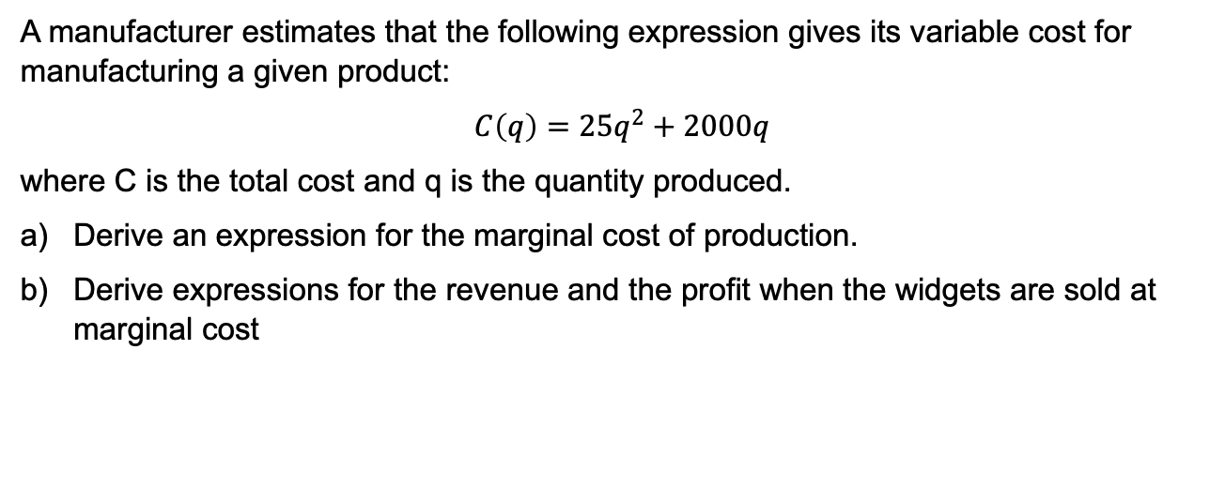
EX1:
A manufacturer estimates that the following expression gives its variable cost for manufacturing a given product:
$$C\left(q\right)=25q^{2}+2000q$$
where C is the total cost and q is the quantity produced.
Derive an expression for the marginal cost of production.
Derive expressions for the revenue and the profit when the widgets are sold at marginal cost

Slide 3
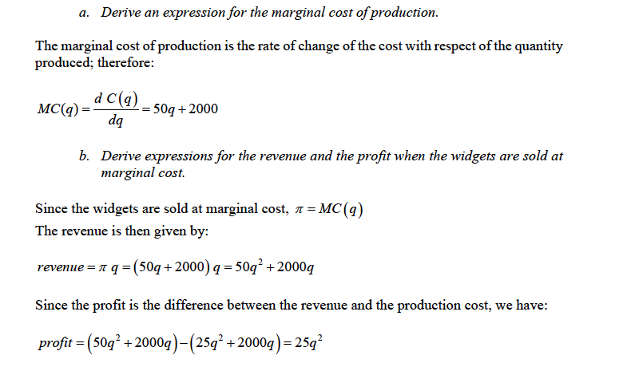
EX1:

Slide 4
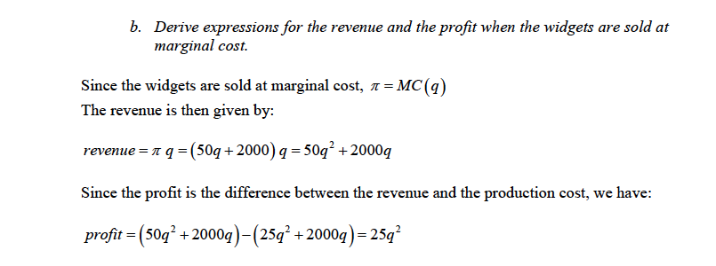
EX1:

Slide 5
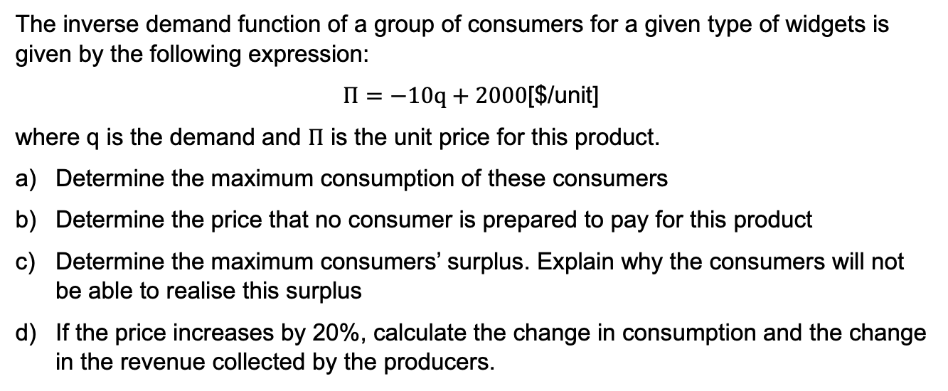
EX2:
The inverse demand function of a group of consumers for a given type of widgets is given by the following expression:
$Π=−10q+2000$[$/unit]
where q is the demand and $Π$ is the unit price for this product.
Determine the maximum consumption of these consumers
Determine the price that no consumer is prepared to pay for this product
Determine the maximum consumers’ surplus. Explain why the consumers will not be able to realise this surplus
If the price increases by 20%, calculate the change in consumption and the change in the revenue collected by the producers.

Slide 6
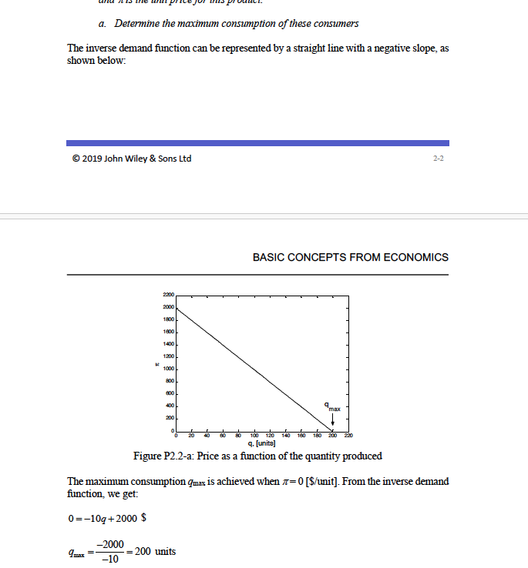
EX2:

Slide 7
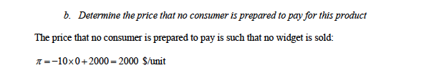
EX2:

Slide 8
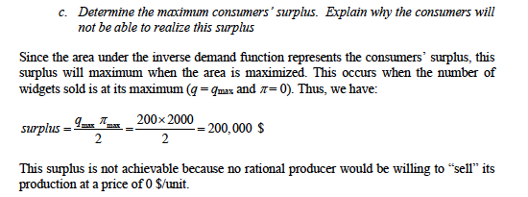
EX2:

Slide 9
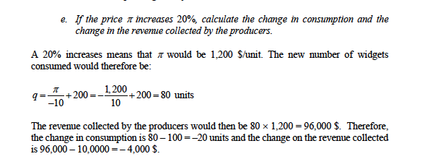
EX2:

Slide 10
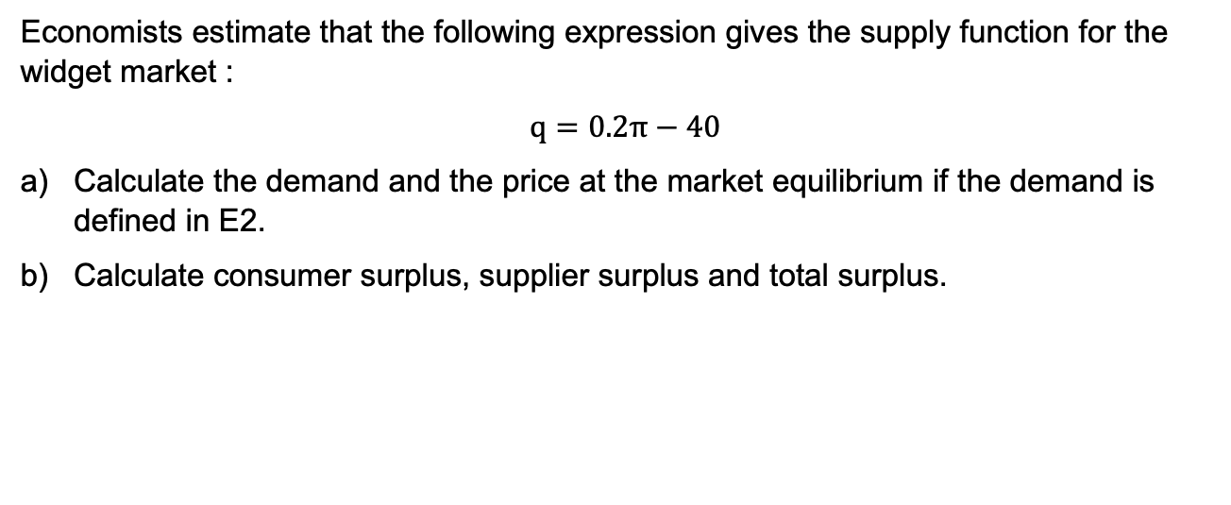
EX3:
Economists estimate that the following expression gives the supply function for the widget market :
$$q=0.2π−40$$
Calculate the demand and the price at the market equilibrium if the demand is defined in E2.
Calculate consumer surplus, supplier surplus and total surplus.

Slide 11
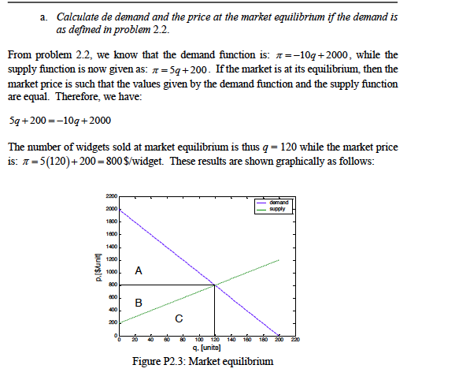
EX3:

Slide 12
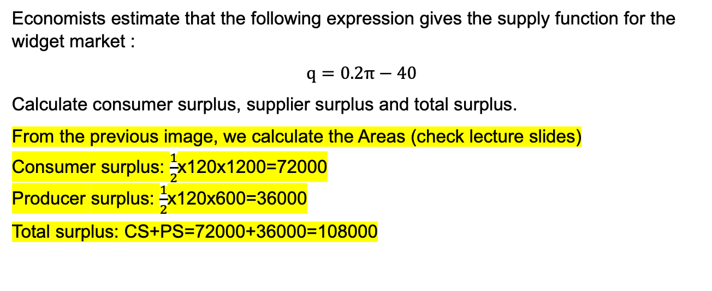
EX3:
Economists estimate that the following expression gives the supply function for the widget market :
$$q=0.2π−40$$
Calculate consumer surplus, supplier surplus and total surplus.
From the previous image, we calculate the Areas (check lecture slides)
Consumer surplus: $\frac{1}{2}$x120x1200=72000
Producer surplus: $\frac{1}{2}$x120x600=36000
Total surplus: CS+PS=72000+36000=108000

Slide 13
EX4:
The production and cost schedule of a firm is provided in the next slide:
What amount should this firm produce if price of a product is $500 per unit? What is the total profit (loss)? Will it be worthwhile for this firm to produce at this point in the short-run? Will this firm continue to produce at this point in the long-run?
What amount should this firm produce if price of a product is $300 per unit? What is the total profit (loss)? Will it be worthwhile for this firm to produce at this point in the short-run? Will this firm continue to produce at this point in the long-run?
What level of output represents the break-even point for this firm? What is the total profit (loss) at this point? Will it be worthwhile for this firm to produce at this point in the short-run? Will this firm continue to produce at this point in the long-run?
What level of output represents the shut-down point for this firm? What is the total profit (loss) at this point? Will it be worthwhile for this firm to produce at this point in the short-run? Will this firm continue to produce at this point in the long-run?

Slide 14
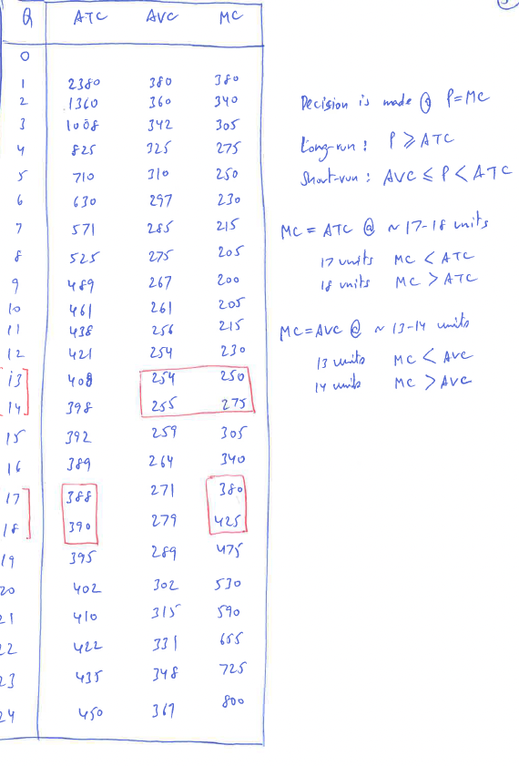
EX4:

Slide 15
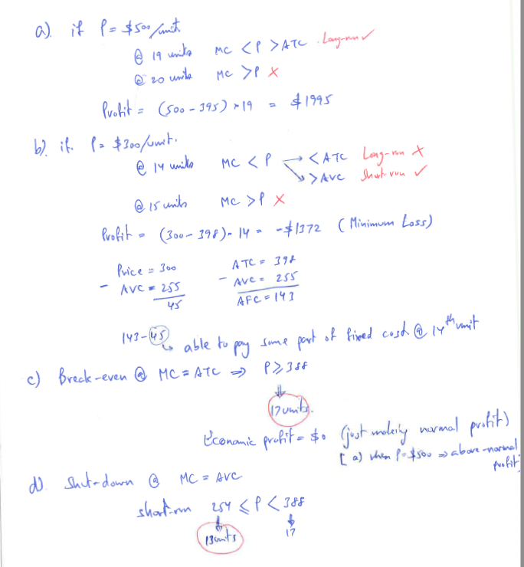
EX4:

Slide 16
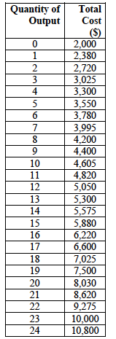
EX4:

Slide 17
EX5:
The operator of a centralised market for electrical energy has received the bids shown in the table below for the supply of electrical energy during a given period:
Company | Amount (MWh) | Price ($/MWh)
Red | 100 | 12.5
Red | 100 | 14.0
Red | 50 | 18.0
Blue | 200 | 10.5
Blue | 200 | 13.0
Blue | 100 | 15.0
Green | 50 | 13.5
Green | 50 | 14.5
Green | 50 | 15.5

Slide 18
EX5:
Build the supply curve.
Assume that this market operates unilaterally, i.e. that the demand does not bid and is represented by a forecast. Calculate the market price, the quantity produced by each company, and the revenue of each company for each of the following loads:
400 MW,
600MW,
875 MW.

Slide 19
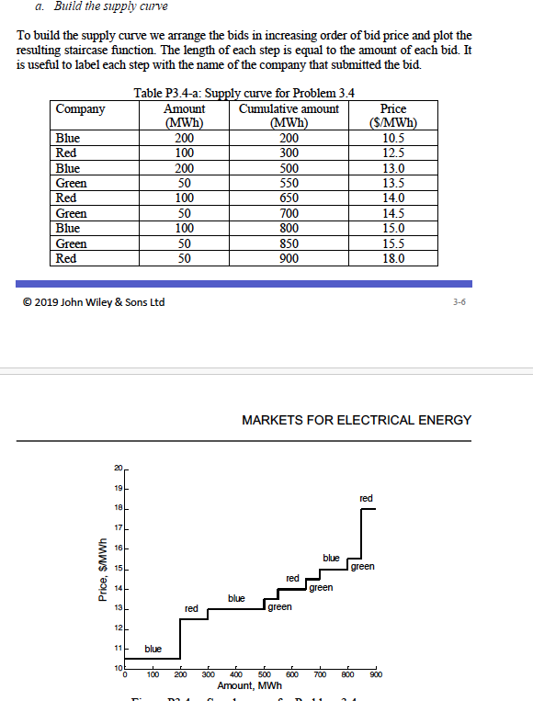
EX5:

Slide 20
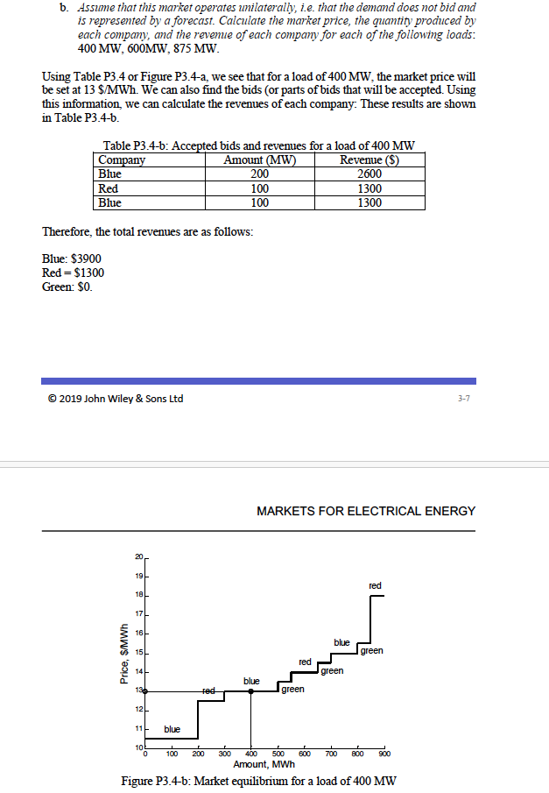
EX5:

Slide 21
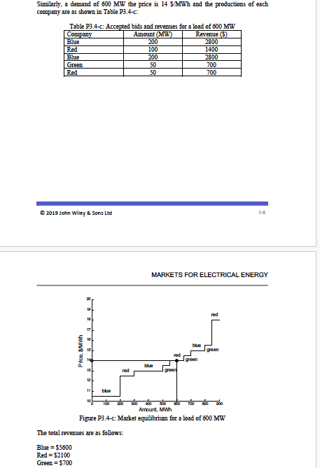
EX5:

Slide 22
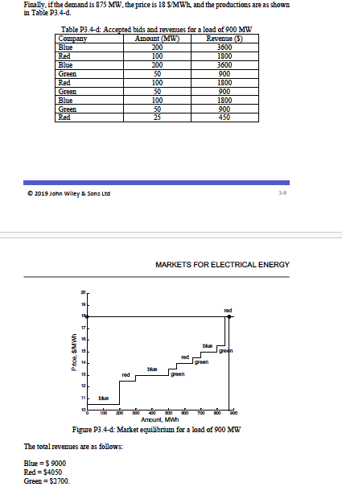
EX5:

